Slide 1




Slide 2
Greedy Search Decoding

Slide 3
What is Greedy Search Decoding?
Greedy Search Decoding is a simple but effective algorithm for decoding text from a sequence-to-sequence model.
Sequence to Sequence Model
Practice,

Slide 4
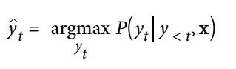
What is Greedy Search Decoding?
Practice,
He 0.6
Great 0.2
Influence 0.2
He

Slide 5
What is Greedy Search Decoding?
Practice,
Influence 0.1
Had 0.2
During 0.2
He
Had
The decoder always chooses the token that it believes is the most likely to be the next token in the output sequence.

Slide 6
How greedy search works?
import torch
from transformers import AutoTokenizer, AutoModelForCausalLM
device = "cuda" if torch.cuda.is_available() else "cpu"
model_name = "gpt2-xl"
tokenizer = AutoTokenizer.from_pretrained(model_name)
model = AutoModelForCausalLM.from_pretrained(model_name).to(device)
input_txt = "Transformers are the"
input_ids = tokenizer(input_txt, return_tensors="pt" )["input_ids" ].to(device)
output = model.generate(input_ids, max_new_tokens= 8, do_sample=False)
print(tokenizer.decode(output[0]))
Transformers are the most popular toy line in the world

Slide 7
Deep dive in Greedy Search Decoding
input_txt = "Transformers are the"
input_ids = tokenizer(input_txt, return_tensors="pt" )["input_ids" ] . to(device)
iterations = []
n_steps = 8
choices_per_step = 5
with torch.no_grad():
for _ in range(n_steps):
iteration = dict()
iteration["Input" ] = tokenizer.decode(input_ids[0])
output = model(input_ids=input_ids)
next_token_logits = output.logits[0, - 1, :]
next_token_probs = torch.softmax(next_token_logits, dim=- 1)
sorted_ids = torch.argsort(next_token_probs, dim=- 1, descending=True)
for choice_idx in range(choices_per_step):
token_id = sorted_ids[choice_idx]
token_prob = next_token_probs[token_id].cpu().numpy()
token_choice =(f"{tokenizer.decode(token_id)} ({100 * token_prob:.2f}%)")
iteration[f"Choice {choice_idx+1}" ] = token_choice
input_ids = torch.cat([input_ids, sorted_ids[None, 0, None]], dim=- 1)
iterations.append(iteration )

Slide 8
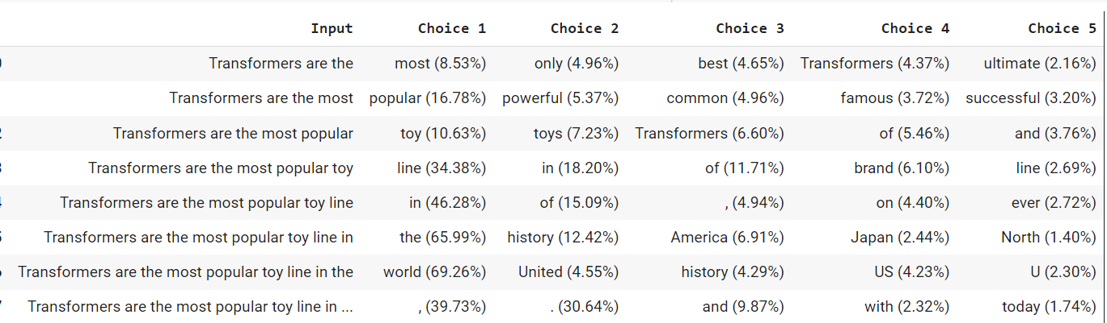
Deep dive in Greedy Search Decoding
import pandas as pd
pd.DataFrame(iterations)
Text generation need to decode the output tokens one at a time.

Slide 9
Deep dive in Greedy Search Decoding
Reproduce the unicorn story from OpenAI
max_length = 128
input_txt = """ In a shocking finding, scientists discovered \
a herd of unicorns living in a remote, previously unexplored \
valley, in the Andes Mountains. Even more surprising to the \
researchers was the fact that the unicorns spoke perfect English. \n\n
"""
input_ids = tokenizer(input_txt, return_tensors="pt" )["input_ids" ].to(device)
output_greedy = model.generate(input_ids,
max_length=max_length,
do_sample=False)
print(tokenizer. decode(output_greedy[0]))
In a shocking finding, scientists discovered a herd of unicorns living in a remote, previously unexplored valley, in the Andes Mountains. Even more surprising to the researchers was the fact that the unicorns spoke perfect English.
The researchers, from the University of California, Davis, and the University of Colorado, Boulder, were conducting a study on the Andean cloud forest, which is home to the rare species of cloud forest trees.
The researchers were conducting a study on the Andean cloud forest, which is home to the rare species of cloud forest trees.
The researchers were conducting a study on

Slide 10
Summary
Greedy search decoding Cons:
Produce repetitive output sequences, which is certainly undesirable in a news article.
Greedy search decoding Pros:
Greedy search decoding is rarely used for text generation tasks that require diversity.
It can be useful for producing short sequences like arithmetic where a deterministic and factually correct output is preferred.

Slide 11
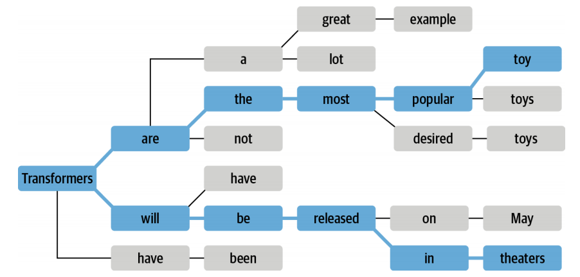
In the next Video
Explore with a popular method known as beam search decoding.

